Slide 1
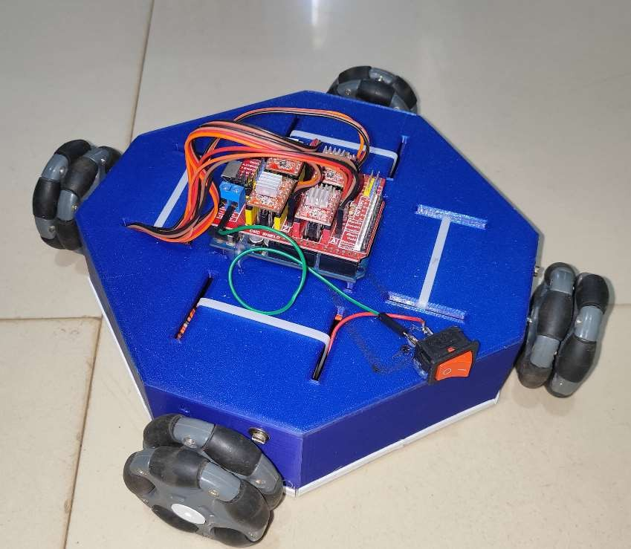
PATH PLANNING OF A WHEELED MOBILE ROBOT しゃりんつき いどうろぼっと の けいろ けいかく
BY:
Kamireddi Manohar
Aditya University

Slide 2
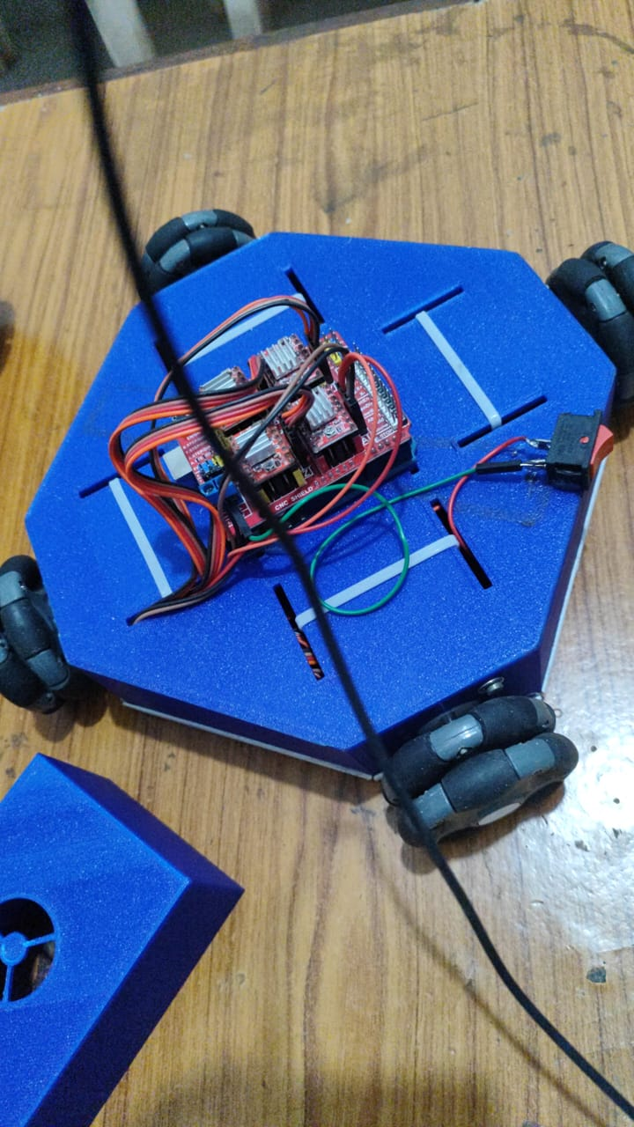
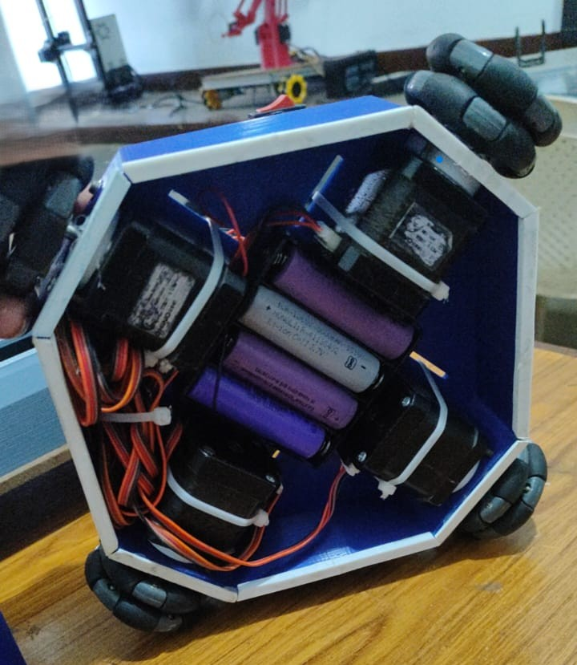
OBJECTIVES
To program a mobile robot to travel the shortest path between two points while avoiding obstacles, MATLAB and Arduino were used for a Sensorless control system.
The path will be determined using the A* search algorithm.
The robot was designed using “On shape” software.

Slide 3
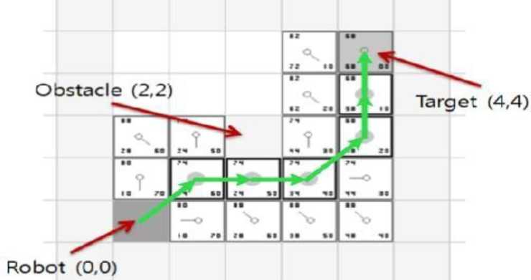
INTRODUCTION
A wheeled mobile robot navigating predetermined obstacles without sensors relies on algorithmic approaches for path planning and obstacle avoidance. One such method is using a pre-mapped environment and a predefined path for the robot to follow.
Algorithms like Dijkstra’s or A* can be employed to determine the optimal path through the given space, considering the predetermined obstacles. The robot’s control system then executes the planned trajectory without real-time sensor feedback.
SHORTEST PATH THAT DODGING THE PREDETERMINED OBSTACLES USING A* ALGORITHM

Slide 4
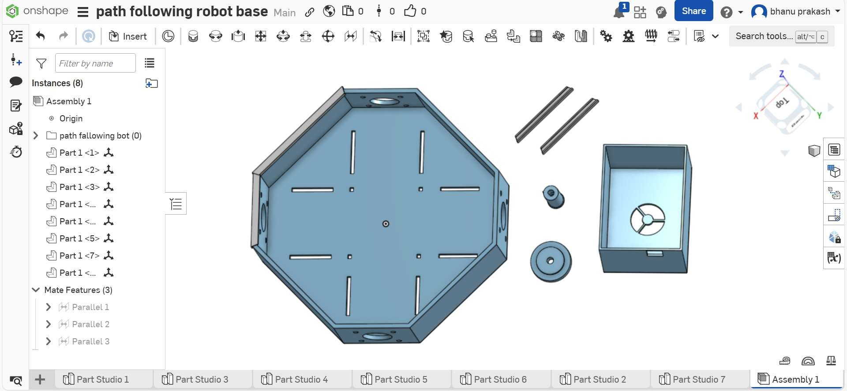
3D DESIGNED PARTS

Slide 5
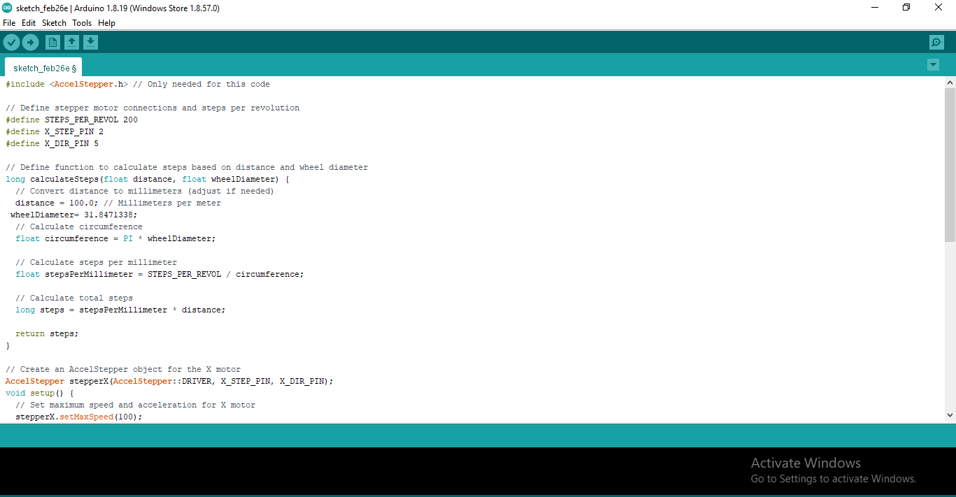
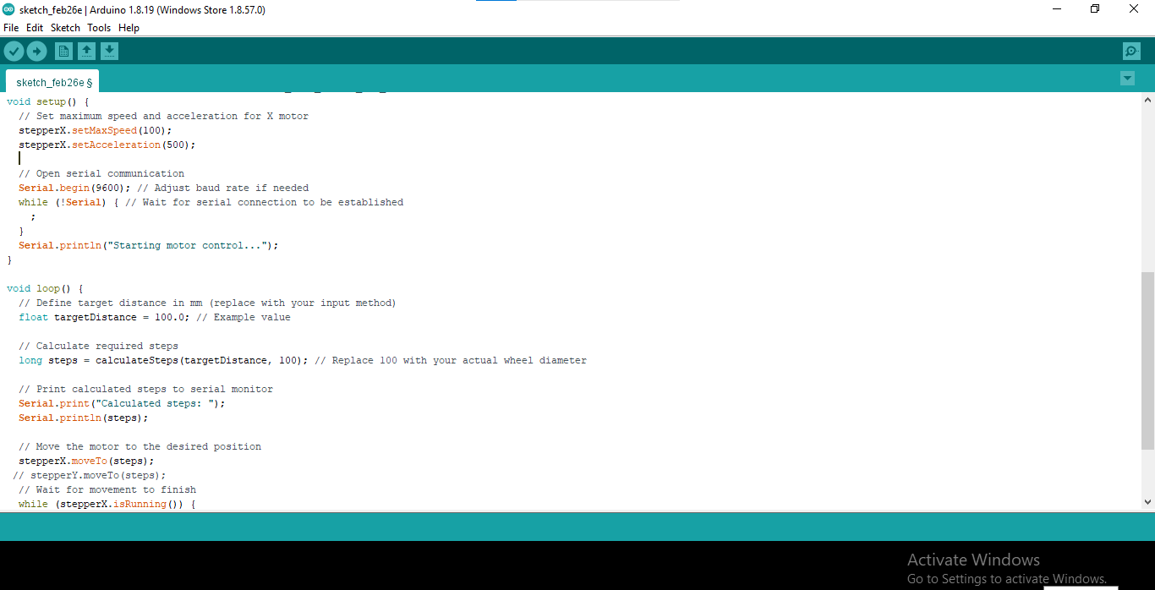
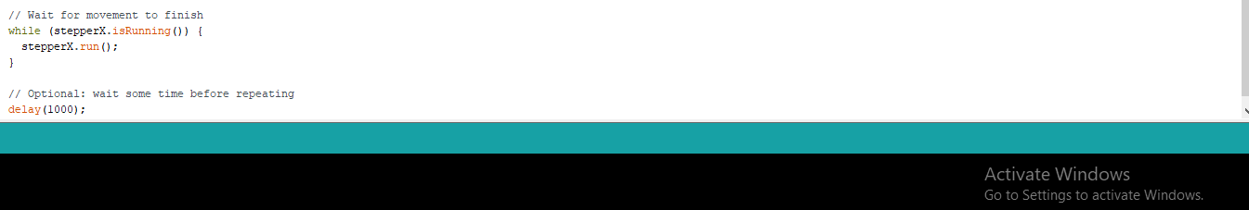
CODE FOR RUNNING A SINGLE STEPPER MOTOR

Slide 6
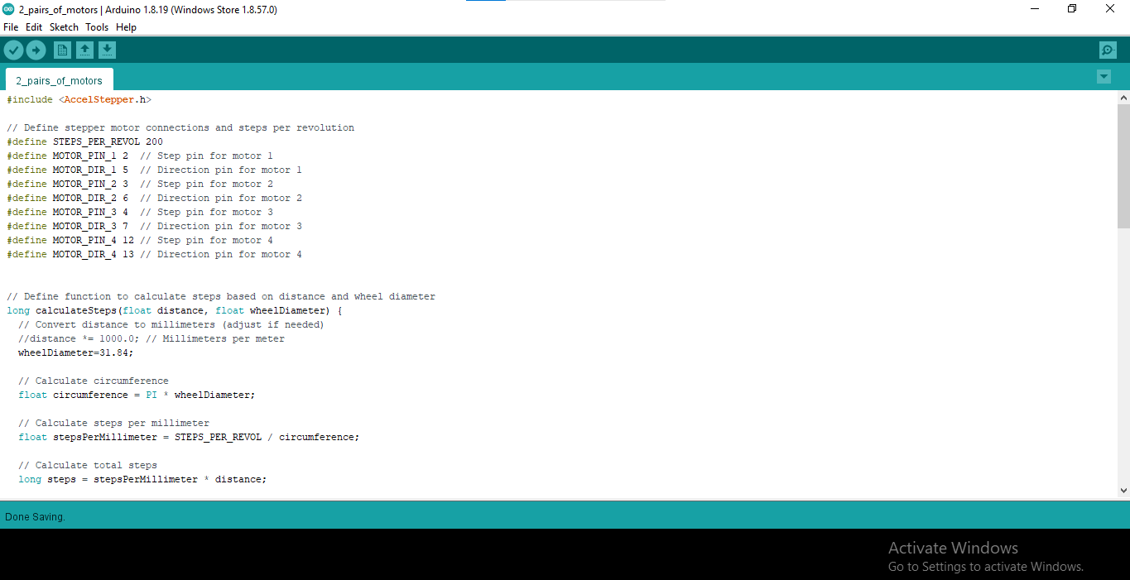
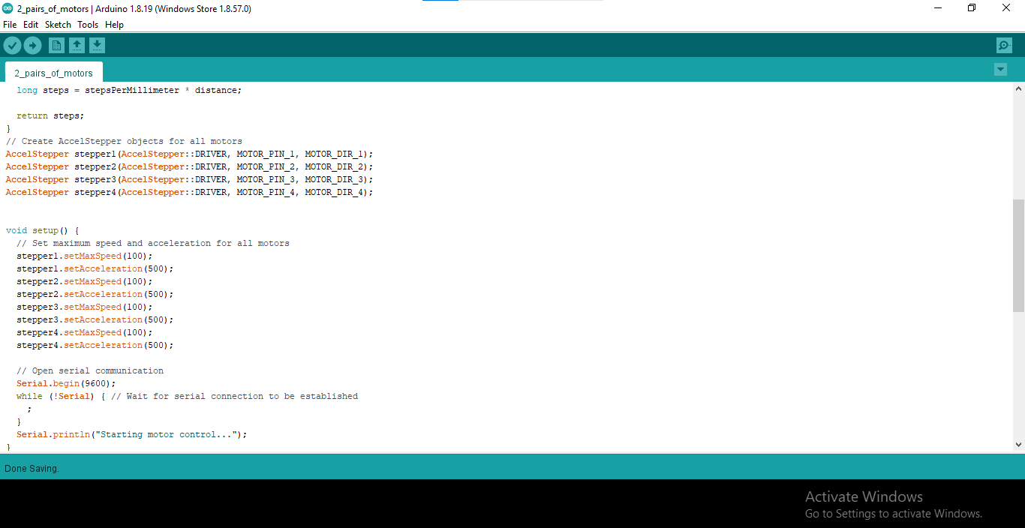
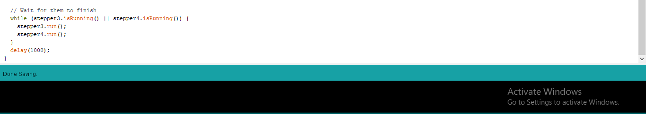
CODE FOR RUNNING Z-AXIS AND X-AXIS MOTORS INDIVIDUALLY

Slide 7
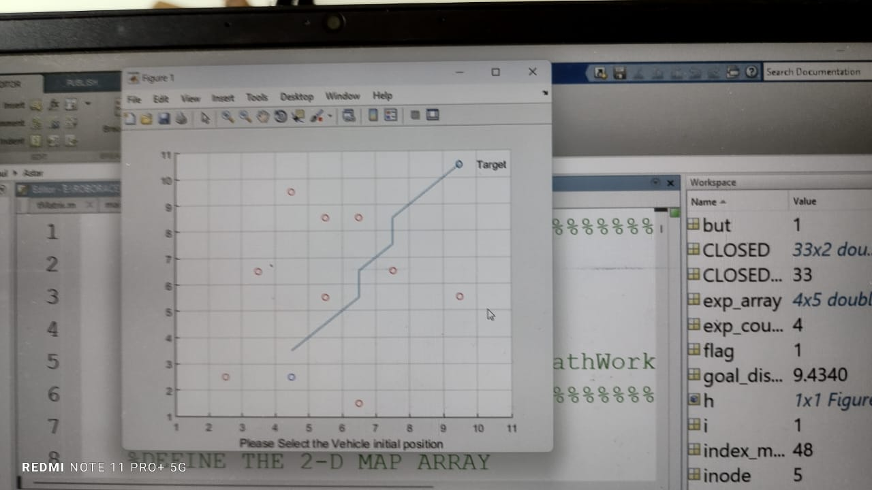
IMPLEMENTATION OF A* ALGORITHM IN MATLAB SIMULATION
Open the A* algorithm file in MATLAB.
Define the robot's start position on the grid map.
Mark the locations of the obstacles on the map.
Select the robot's final goal position.
Run the algorithm to find the shortest path
CONCLUTION
The project successfully developed a safe path planning system for a mobile robot, ensuring collision-free and optimized navigation around predetermined, static obstacles

Slide 8



